Slide 1

Installing Linux on a Tablet
Reasons and How-To Guide

Slide 2

Introduction
Why Install Linux on a Tablet?
Customization
Open-Source Software
Security
Privacy
How-To

Slide 3

Reason 1 - Customization
Linux allows you to personalize your tablet's user interface, software, and functionality.
Many different distributions to choose from
Root access to a tablet allows you to change or modify any system files as well as remove software

Slide 4

Reason 2 - Open-Source Software
Linux offers a vast ecosystem of open-source applications, providing flexibility and choice for users.
The communities that work on and develop this software can be extremely helpful and provide great documentation on the software they create.

Slide 5

Reason 3 - Security
Linux is known for its robust security features, reducing the risk of malware and data breaches.
Since you have root access to the tablet you can tweak any security settings that you feel are necessary.
Linux allows you to fine tune permissions, firewall rules, and encryption options.

Slide 6

Reason 4 - Privacy
Linux gives you more control over your data and privacy compared to some proprietary operating systems.
No forced updates
Third-party privacy tools
Community auditing

Slide 7
How-To Guide
Unlocking the bootloader
Flash TWRP custom recovery
Installing linux

Slide 8
Unlocking the Bootloader
Install Android SDK
Enable USB Debugging and OEM Unlocking
Boot device to Fastboot Mode
Unlock Bootloader via Fastboot Command

Slide 9
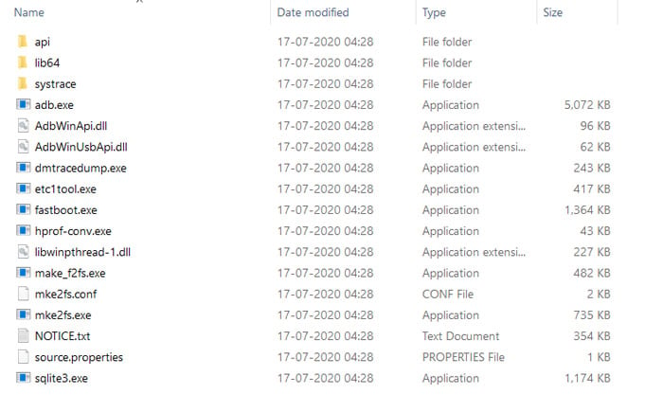
Install Android SDK
The Android SDK (Software Development Kit) is a set of tools that aid in the process of rooting the tablet.
Two main tools that will be used are adb (Android Debug Bridge) and fastboot.
adb is used to enable the use of a command line to communicate to the device.
Fastboot allows us to launch the table independently of the operating system.

Slide 10
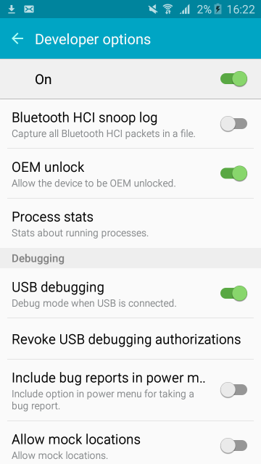
Enable USB Debugging and OEM Unlocking
USB Debugging allows us to transfer files between our computer and the tablet
OEM Unlocking permits the ability to install a new image or a new bootloader onto the device.
How to enable USB Debugging and OEM Unlocking

Slide 11
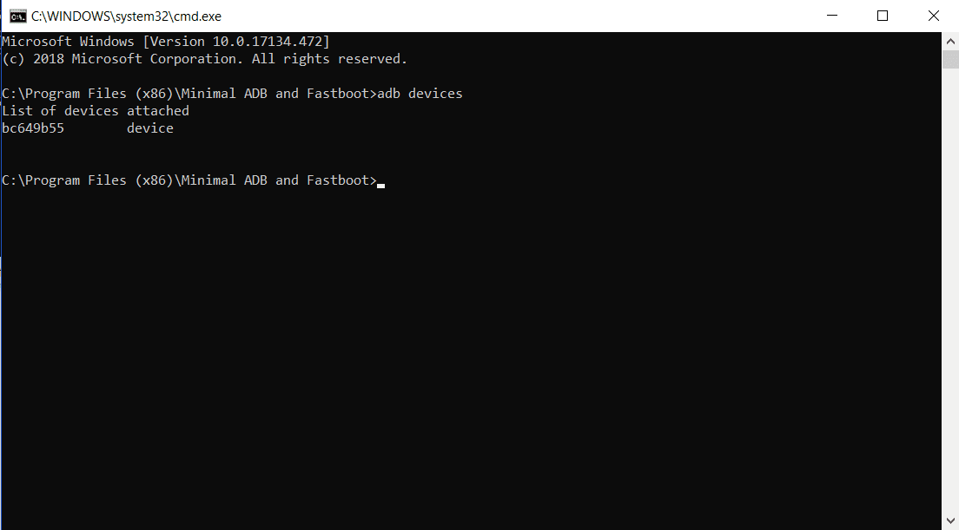
Boot Device to Fastboot Mode
To do so connect the device to your computer and open the platform tools folder from the Android SDK.
Open a command line and run the command “adb reboot bootloader”.
Once the device has rebooted run the command “fastboot devices” this command should verify your device is in fastboot.

Slide 12
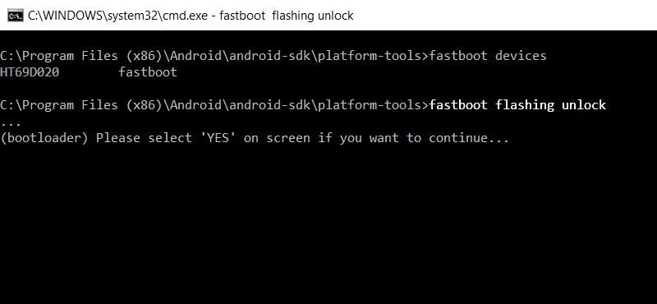
Unlocking Bootloader
The final step in unlocking the bootloader is to run the command “fastboot flashing unlock” this command will prompt the user to confirm the change on their device.
If the device does not reboot on its own run the command “fastboot reboot”.

Slide 13
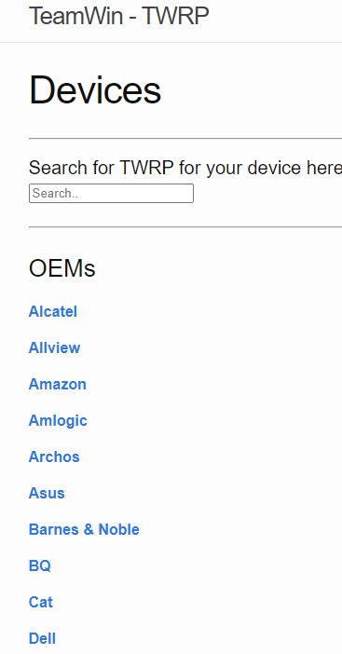
Flash the TWRP Custom Recovery
Now that the bootloader has been unlocked, we need to search for a custom recovery for our device. These can often be found by searching websites such as XDA Developers and TWRP.
Once you find the recovery image download it and boot it into the TWRP application.
Once this is completed you will now have a copy of the firmware on your device with root access.
Now reboot your device

Slide 14
Installing Linux
The process of installing linux on a rooted device is a straightforward process and the steps are as follows:
Connect to wifi
Install BusyBox
Install Linux Deploy
Open BusyBox and tap Start
Tap settings
Choose a linux distibution

Slide 15
Installing Linux Cont.
Check the enable box under GUI to view a linux desktop
Open graphics and select VNC
Choose the desktop environment you want under GUI settings
Find the user name and password fields and edit them
Exit the menu and tap the three dots in the upper-right corner
Select install, then OK
You can now download VNC Viewer off the Play Store and connect to localhost:5900 to view the linux desktop

Slide 16
Drawbacks of Loading Another Operating System on a Tablet
While the process may seem straightforward there are many instances in which this process may fail and make the rest of the steps impossible to complete.
An example of such problems that can occur is the very one we ran into with our own device
While looking for the proper firmware for your device it is possible that the manufacturer lacks the proper documentation to find the necessary firmware needed to root your device.

Slide 17
Alternative ways of using Linux on a tablet
If you are looking to simply connect to savage from a laptop environment for a cheap and portable workstation you can find many different apps to do so.
We chose to use an app called Termux. This app allows you to use a terminal to ssh into savage and operate just like any other workstation.
However, Termux is no longer supported on the Play Store so you must follow a few extra steps to be able to access it.

Slide 18

Installing Termux
You can find the download the latest mirror for Termux on https://github.com/AndronixApp/termux-releases/releases/tag/0.118
Once you download the apk there should be a popup warning you. Click on the settings option and turn on the radio button. Now hit back a few times until a pop up appears asking you to install termux
Once you install termux you are now able to connect to savage.

Slide 19

Any Questions?

